Slide 1
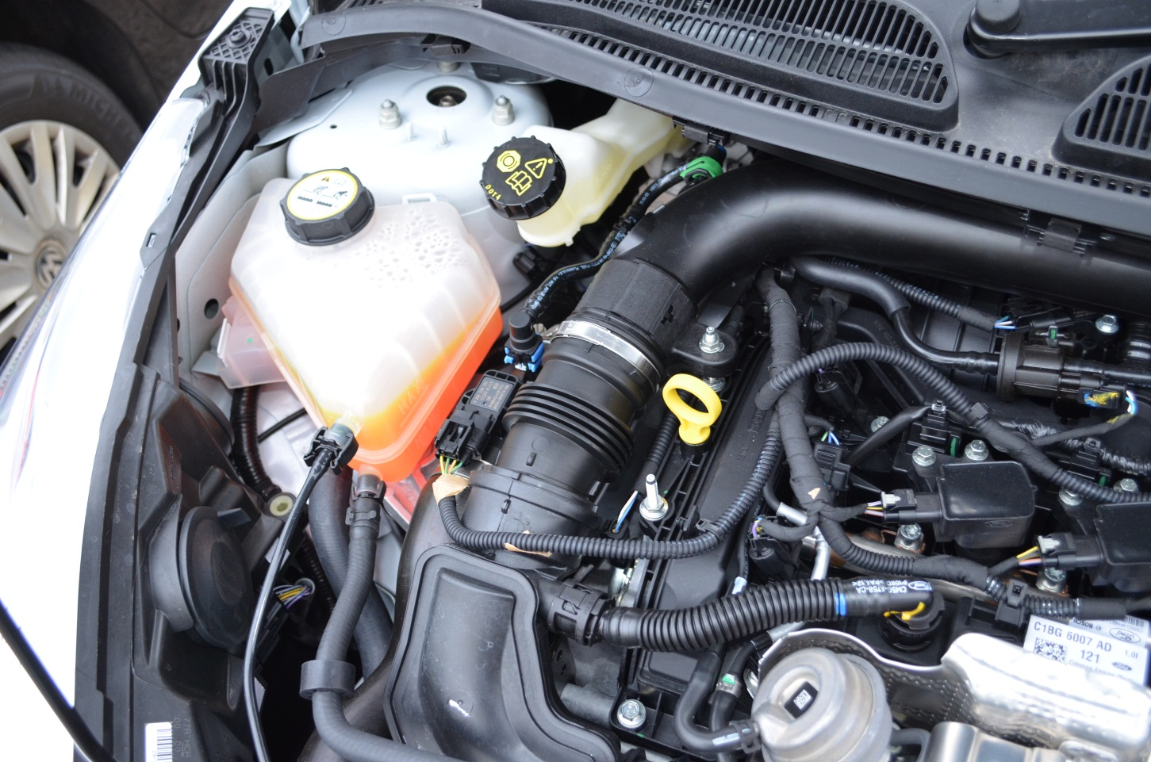
Oil dipstick
Remove dipstick
Clean it
Replace & remove
Level of oil should read between
the min & max level at the bottom of stick
Min & Max level
Engine coolant
reservoir
Brake fluid
reservoir
Min & Max level

